Slide 1
FLUORESCENCE MICROSCOPY IMAGE SEGMENTATION USING CONVOLUTIONAL NEURAL NETWORK WITH GENERATIVE ADVERSARIAL NETWORKS
Fu, C., Lee, S., Ho, D. J., Han, S., Salama, P., Dunn, K. W., & Delp, E. J. arXiv preprint arXiv:1801.07198 (2018)
Presented by Runyu Hong
2018.04.26

Slide 2
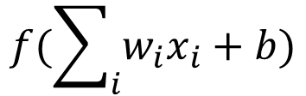
General Neural Network Architecture
David Fenyo, Machine Learning Course 2018
x₁
w₁
$$f(\sum_{i}{{w_{i}x}_{i}}+b)$$
2
w₂
x₂
.
.
.
x_{n}
w_{n}
Input
Output
Hidden

Slide 3
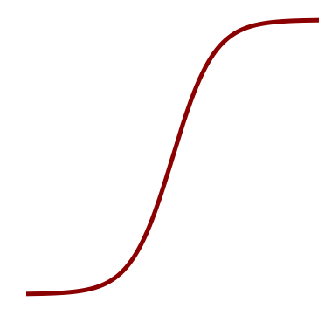
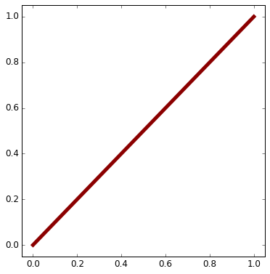
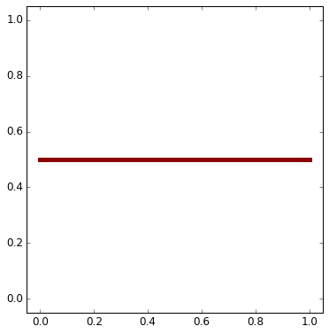
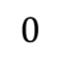
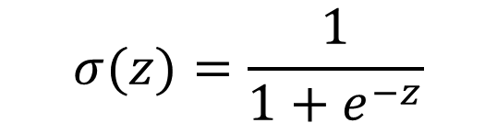
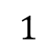
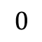
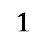
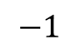
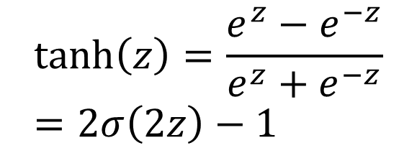
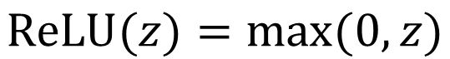
Activation Functions
David Fenyo, Machine Learning Course 2018
$$1$$
3
$$σ(z)=\frac{1}{1+e^{−z}}$$
Sigmoid:
Hyperbolic
tangent:
ReLu:
$$0$$
$$1$$
$$tanh\left(z\right)=\frac{e^{z}−e^{−z}}{e^{z}+e^{−z}}=2σ\left(2z\right)−1$$
$$−1$$
z
$$ReLU(z)=max⁡(0,z)$$
$$0$$
Notes:
Activation functions are really important for a Artificial Neural Network to learn and make sense of something really complicated and Non-linear complex functional mappings between the inputs and response variable.Theyintroduce non-linear properties to our Network.Their main purpose is to convert a input signal of a node in a A-NN to an output signal. That output signal now is used as a input in the next layer in the stack.
If we do not apply a Activation function then the output signal would simply be a simple linear function.A linear function is just a polynomial of one degree. Now, a linear equation is easy to solve but they are limited in their complexity and have less power to learn complex functional mappings from data. A Neural Network without Activation function would simply be a Linear regression Model, which has limited power and does not performs good most of the times. We want our Neural Network to not just learn and compute a linear function but something more complicated than that. Also without activation function our Neural network would not be able to learn and model other complicated kinds of data such as images, videos , audio , speech etc. That is why we use Artificial Neural network techniques such as Deep learning to make sense of something complicated ,high dimensional,non-linear -big datasets, where the model has lots and lots of hidden layers in between and has a very complicated architecture which helps us to make sense and extract knowledge form such complicated big datasets.

Slide 4
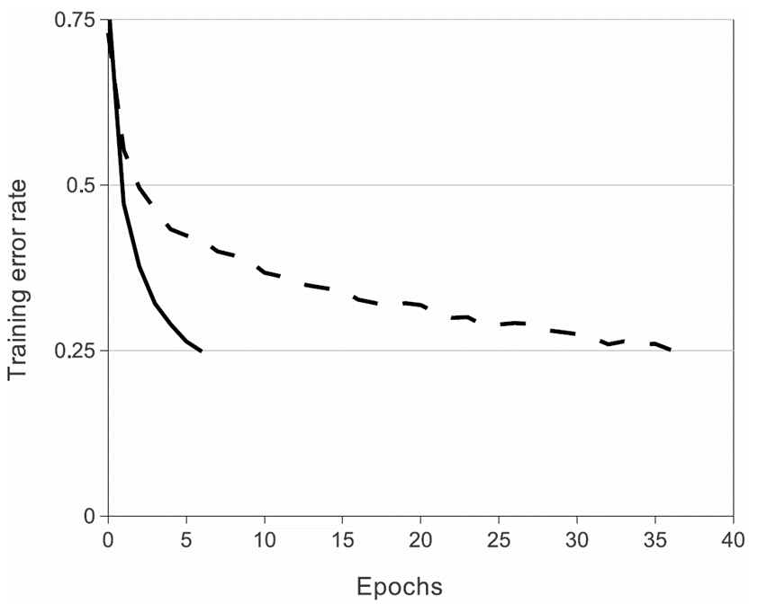
Faster Learning with ReLU
David Fenyo, Machine Learning Course 2018
4
A four-layer convolutional neural network with ReLUs (solid line) reaches a 25% training error rate on CIFAR-10 six times faster than an equivalent network with tanh neurons (dashed line).
Krizhevsky A, Sutskever I, Hinton GE. Imagenet classification with deep convolutional neural networks. In Advances in Neural Information Processing Systems 2012 (pp. 1097-1105).

Slide 5
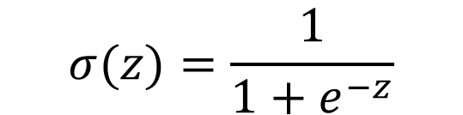

Activation Functions for Output Layer
David Fenyo, Machine Learning Course 2018
5
$$σ(z)=\frac{1}{1+e^{−z}}$$
Binary classification: Sigmoid:
Multi-class classification: Softmax
$$=\frac{e^{z_{k}}}{\sum_{j}{e^{z_{j}}}}$$

Slide 6
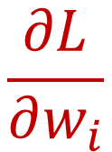
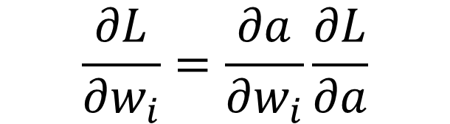
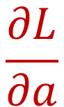
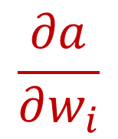
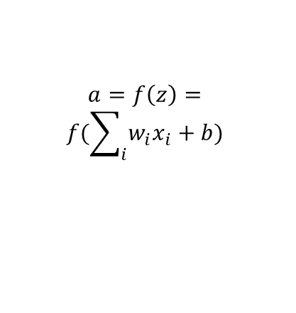
Backpropagation
David Fenyo, Machine Learning Course 2018
$$\frac{∂a}{∂w_{i}}$$
x₁
w₁
$$a=f\left(z\right)=$$
$$f(\sum_{i}{{w_{i}x}_{i}}+b)$$
6
$$\frac{∂L}{∂w_{i}}$$
w₂
$$\frac{∂L}{∂a}$$
x₂
f(z)
.
.
.
x_{n}
w_{n}
Chain Rule
$$\frac{∂L}{∂w_{i}}=\frac{∂a}{∂w_{i}}\frac{∂L}{∂a}$$

Slide 7
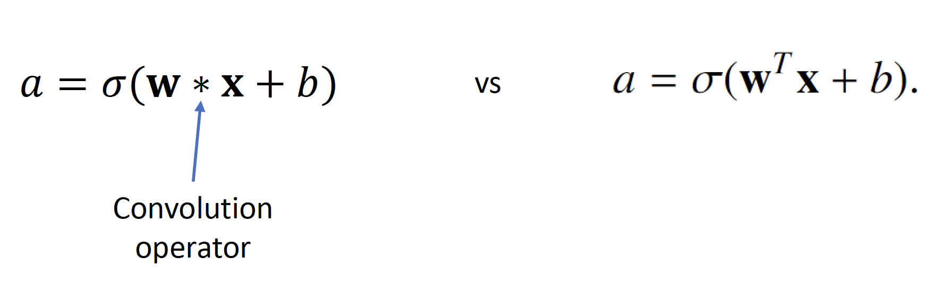
Convolutional neural networks (CNNs)
David Fenyo, Machine Learning Course 2018
Local receptive field
Demo
Convolution
Linear
Shared weights and biases
LeCun Y, Bottou L, Bengio Y, Haffner P. Gradient-based learning applied to document recognition. Proceedings of the IEEE. 1998 Nov;86(11):2278-324.

Slide 8
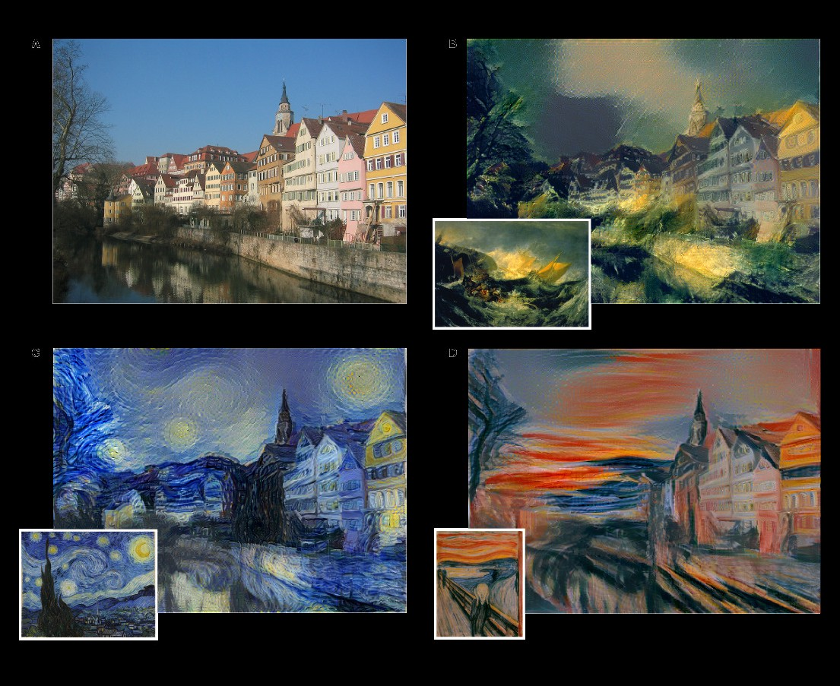
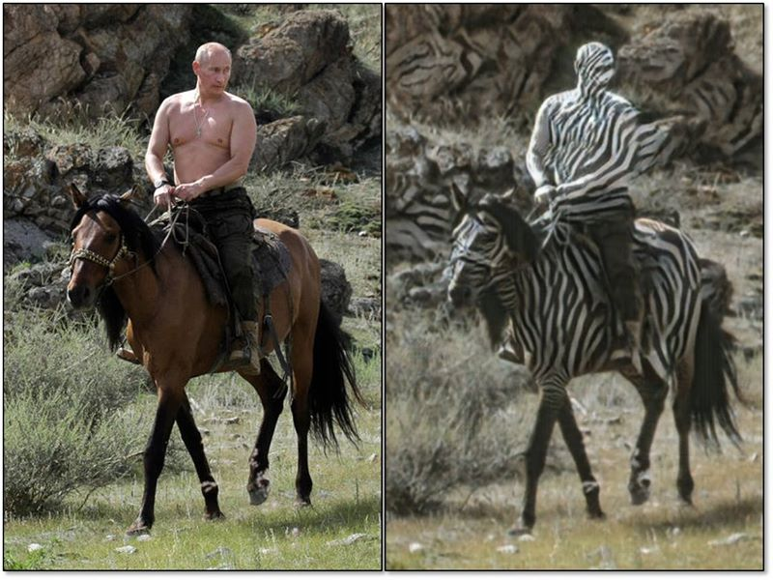
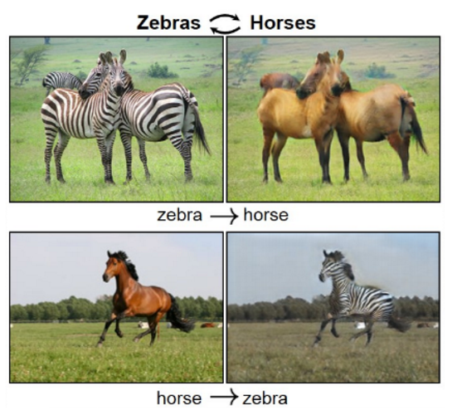
Generative Adversarial Networks (GANs)
Narges Razavian, Deep Learning Course 2018
Counterfactuals/data transformations:
What would my patient/DNA/image/etc. be like, if it was from class B?
Personalized inference
What would my patient’s future be like?
Data Augmentation
What are some other samples from my class A,B,C, etc?
Fun/Art (for now)

Slide 9
Narges Razavian, Deep Learning Course 2018
Generator objective: Generate images such that discriminator can not distinguish.
i.e. Objective: Fool the discriminator so it predicts REAL.
Discriminator objective: Say REAL when it sees ground truth, and say FAKE when it sees a generated image
Notations:
Z: Input to the generator
G_{θ1}(Z): Generator Network
X = G_{θ1}(Z): Generated Image
Y: Binary Random Variable (Y=1 means image is predicted as REAL)
D_{θ2}(X): Discriminator Network
P_{D}(Y=1|X) = D_{θ2}(X)
Generator Objective: Maximize Log (P(Y=1| G_{θ1}(Z))) = Maximize Log(D_{θ2}(G_{θ1}(Z)))
Discriminator Objective: Maximize Log(D_{θ2}(X))_{{x ~ real}} + Log (P(Y=0 | G_{θ1}(Z)))_{{z ~ noise}}

Slide 10
Generator Network
G_{θ1}(Z)
Generated output
(X)
Narges Razavian, Deep Learning Course 2018
Random Noise
(Z)
Discriminative Network
D_{θ2}(X)
Is this a real Image?
Ground Truth
(X*)
Generator Objective: Maximize Log(D_{θ2}(G_{θ1}(Z))) → {or rather minimize the negative of this}
Discriminator Objective: Maximize Log(D_{θ2}(X))_{{x ~ real}} + Log (1 - D_{θ2}(G_{θ1}(Z)))_{{z ~ noise}}

Slide 11
Generator Network
G_{θ1}(Z)
Generated output
(X)
Narges Razavian, Deep Learning Course 2018
Random Noise
(Z)
Discriminative Network
D_{θ2}(X)
Is this a real Image?
Ground Truth
(X*)
Generator Objective: Maximize Log(D_{θ2}(G_{θ1}(Z))) → {or rather minimize the negative of this}
Discriminator Objective: Maximize Log(D_{θ2}(X))_{{x ~ real}} + Log (1 - D_{θ2}(G_{θ1}(Z)))_{{z ~ noise}}

Slide 12
Generator Network
G_{θ1}(Z)
Generated output
(X)
Narges Razavian, Deep Learning Course 2018
Random Noise
(Z)
Discriminative Network
D_{θ2}(X)
Is this a real Image?
Only update this network’s parameters
Ground Truth
(X*)
Generator Objective: Maximize Log(D_{θ2}(G_{θ1}(Z))) → {or rather minimize the negative of this}
Discriminator Objective: Maximize Log(D_{θ2}(X))_{{x ~ real}} + Log (1 - D_{θ2}(G_{θ1}(Z)))_{{z ~ noise}}

Slide 13
Generator Network
G_{θ1}(Z)
Generated output
(X)
Narges Razavian, Deep Learning Course 2018
Random Noise
(Z)
Discriminative Network
D_{θ2}(X)
Is this a real Image?
Ground Truth
(X*)
Generator Objective: Maximize Log(D_{θ2}(G_{θ1}(Z))) → {or rather minimize the negative of this}
Discriminator Objective: Maximize Log(D_{θ2}(X))_{{x ~ real}} + Log (1 - D_{θ2}(G_{θ1}(Z)))_{{z ~ noise}}

Slide 14
Generator Network
G_{θ1}(Z)
Generated output
(X)
Narges Razavian, Deep Learning Course 2018
Random Noise
(Z)
Discriminative Network
D_{θ2}(X)
Is this a real Image?
Ground Truth
(X*)
Generator Objective: Maximize Log(D_{θ2}(G_{θ1}(Z))) → {or rather minimize the negative of this}
Discriminator Objective: Maximize Log(D_{θ2}(X))_{{x ~ real}} + Log (1 - D_{θ2}(G_{θ1}(Z)))_{{z ~ noise}}

Slide 15
Only update this network’s parameters
Generator Network
G_{θ1}(Z)
Generated output
(X)
Random Noise
(Z)
Discriminative Network
D_{θ2}(X)
Is this a real Image?
Ground Truth
(X*)
Generator Objective: Maximize Log(D_{θ2}(G_{θ1}(Z))) → {or rather minimize the negative of this}
Discriminator Objective: Maximize Log(D_{θ2}(X))_{{x ~ real}} + Log (1 - D_{θ2}(G_{θ1}(Z)))_{{z ~ noise}}
Narges Razavian, Deep Learning Course 2018

Slide 16
Only update this network’s parameters
Generator Network
G_{θ1}(Z)
Generated output
(X)
Random Noise
(Z)
Discriminative Network
D_{θ2}(X)
Is this a real Image?
Ground Truth
(X*)
Generator Objective: Maximize Log(D_{θ2}(G_{θ1}(Z))) → {or rather minimize the negative of this}
Discriminator Objective: Maximize Log(D_{θ2}(X))_{{x ~ real}} + Log (1 - D_{θ2}(G_{θ1}(Z)))_{{z ~ noise}}
Narges Razavian, Deep Learning Course 2018

Slide 17
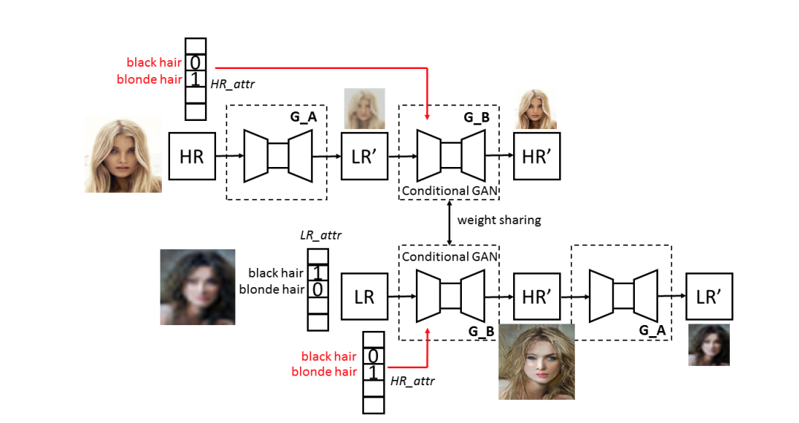
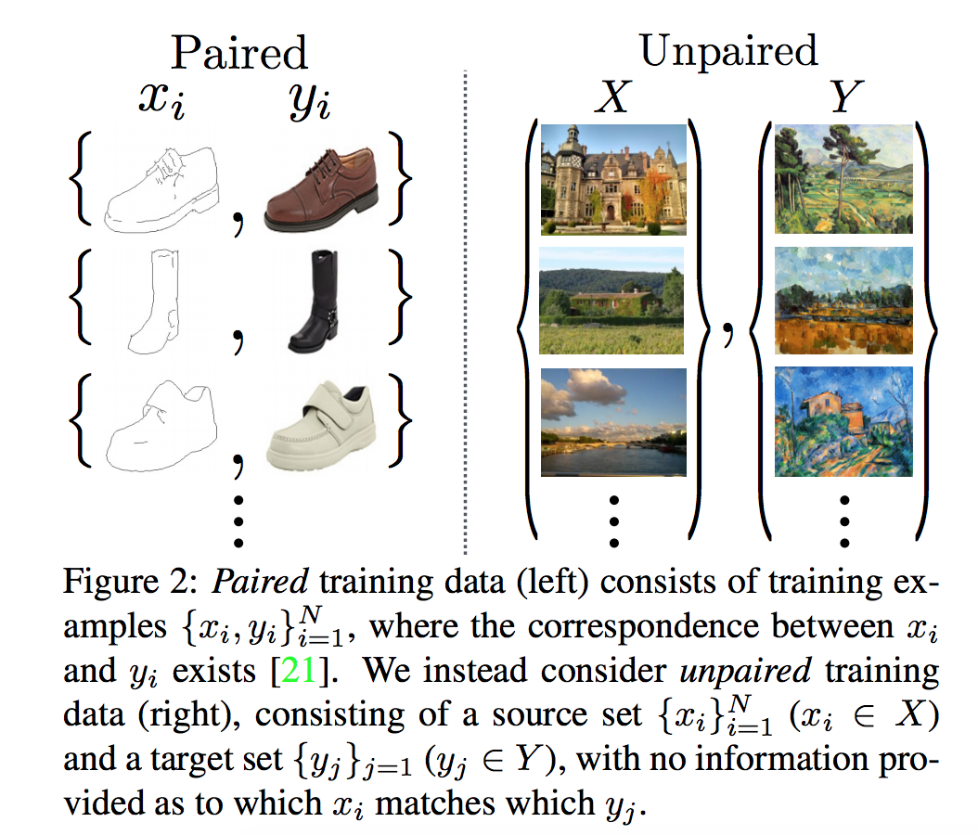
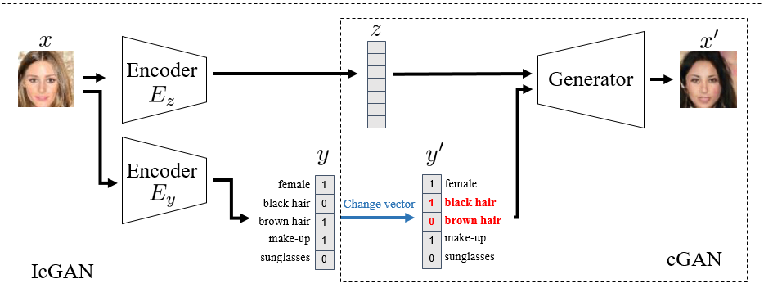
Flavors of GAN
Conditional GAN (CGAN): the generator learns to generate a fake sample with a specific condition or characteristics (such as a label associated with an image or more detailed tag) rather than a generic sample from unknown noise distribution.
Invertible Conditional GAN (ICGAN)
Cycle GAN: Image to image translation. Unpaired training data.
Class conditional Cycle GAN

Slide 18
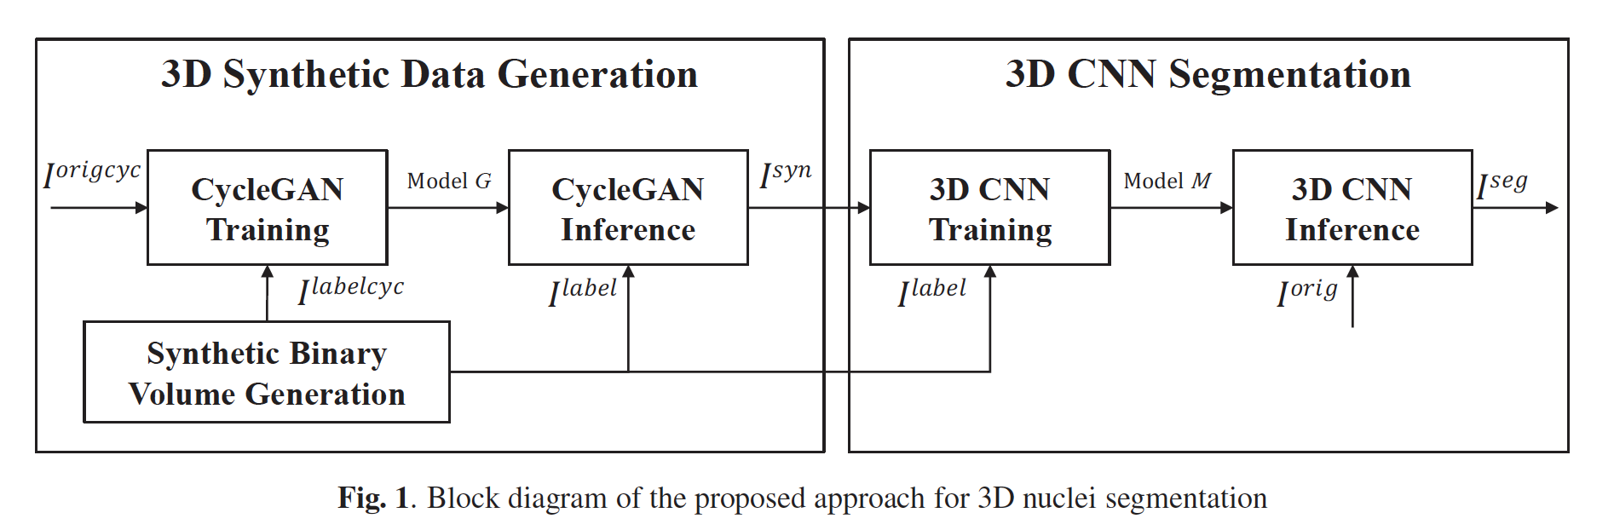
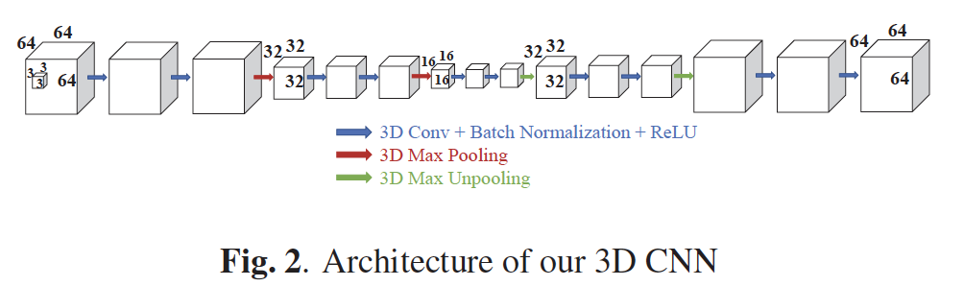

Slide 19
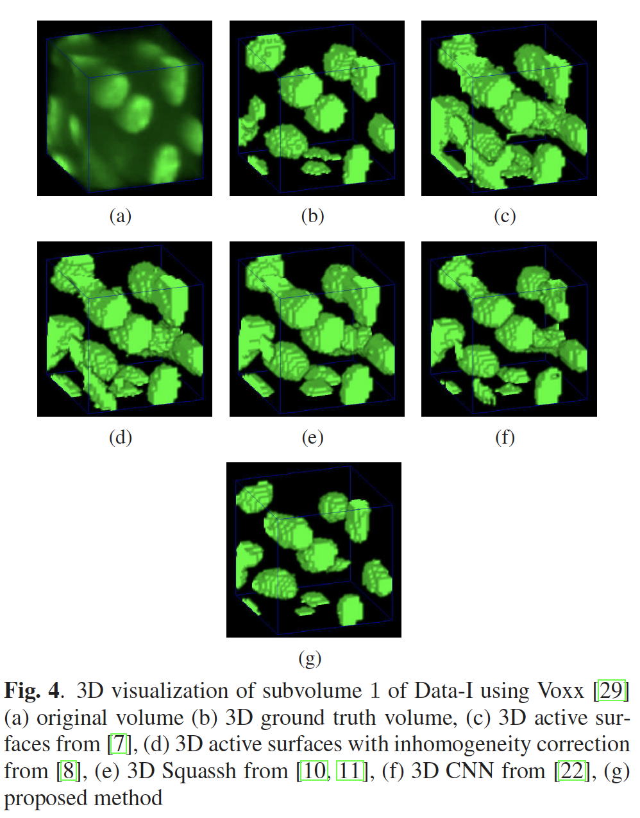
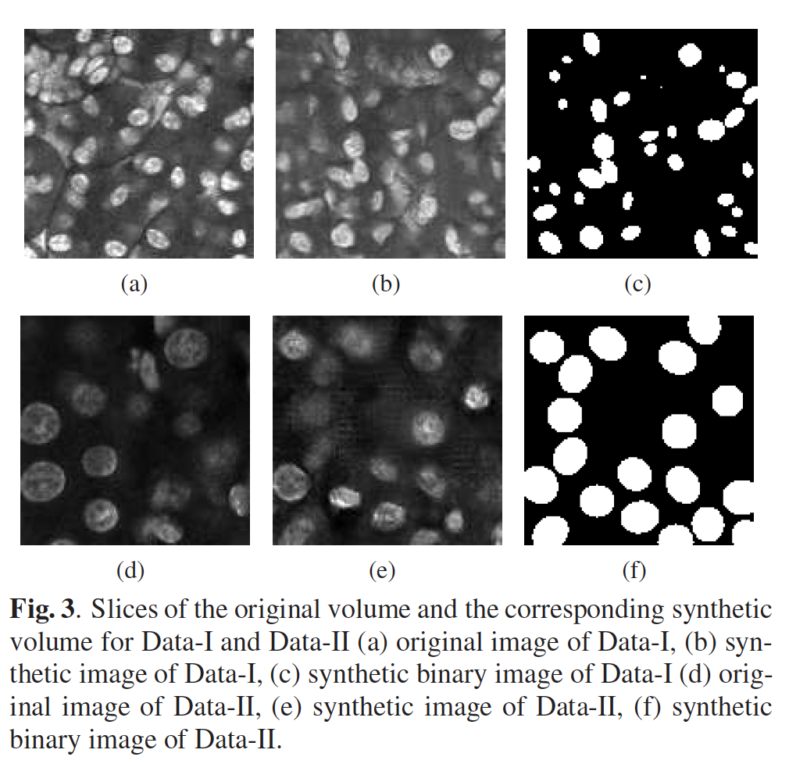

Slide 20
